Slide 1
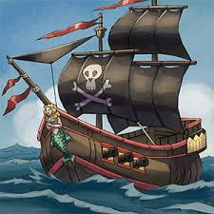
A Pirate’s Life
Group 11: Jon Heikkinen, Alen Peter, Michael Chau, Alejandro Cabral

Slide 2
Project description
A Pirate’s Life is a new adventure game that allows players to start their own pirate crew and build it from the ground up.
Players will be able to choose 2 different regions of the world, the Caribbean, or the South China Sea. Each region will take place in separate time periods and contain separate save states for the player.
In each region players will be able to battle enemy ships, raid towns and cities, and find lost treasure in order to gain gold and increase their infamy.

Slide 3
System requirements
System is required to seamlessly allow 1000s of players to connect at the same time without too much straining.
Map must be able to read weather data and quickly adapt to changes in the weather in a smooth way that would mimic real life.
System will require an extensive anti-cheat program in order to prevent players from being able to cheat in a multitude of ways.
Notes:
Need efficient code that can handle 1000s of connections and update player clients quickly.
Will require an additional custom designed system for smoothly transitioning the weather within the game.

Slide 4
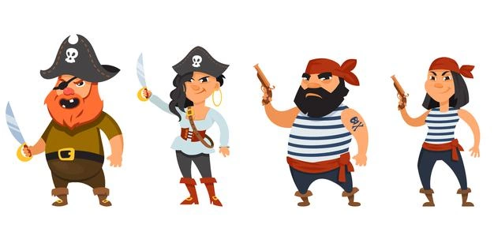
Object requirements
Player object: Ability to track player progress as well as keep track of any quests/challenges they have completed.
Pirate NPC objects: React to their surroundings and fight dynamically in order to increase the realism of the world. This will require an extremely robust AI to control their behavior.
Notes:
Must be able to track things such as gold earned, experience, as well as the player’s crew mates that are on their ship.
Will also require a system for spawning these pirate NPCs into the game world

Slide 5
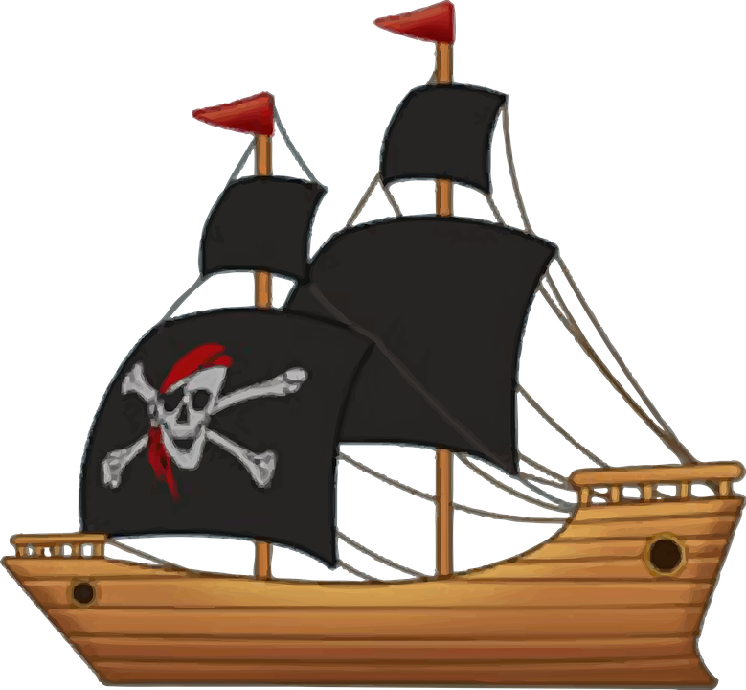
Object requirements pt. 2
Objective object: Contain steps to complete, as well as the rewards for completing the objective
Ship object: Track the health of the ship as well as the speed and direction of the ship depending on the sails and wind direction.
Notes:
This will include quests, as well as raids on towns/fortresses
On top of that, ship must be able to calculate water filling in through holes caused by cannonballs or other weaponry.

Slide 6
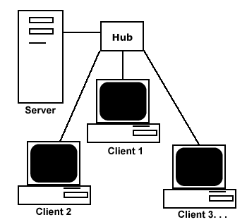
System Design: Architecture
Client-Server Model
Clients would be connected to the server via Internet
Server would ideally be hosted in Midwest(Chicago) for balanced ping
Distributed denial of service (DDoS) protection implemented on server
Frequent server maintenance

Slide 7
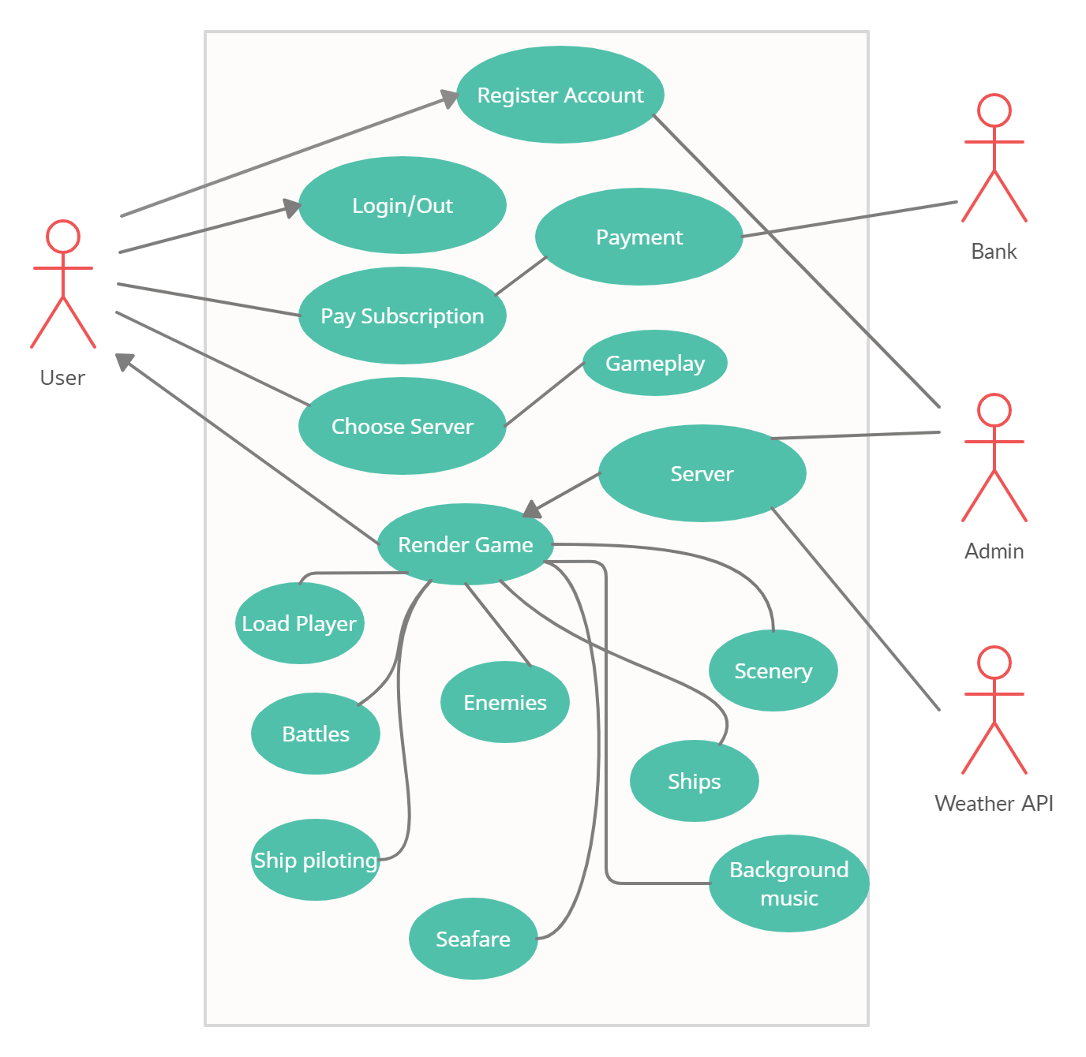
Use case Diagram

Slide 8
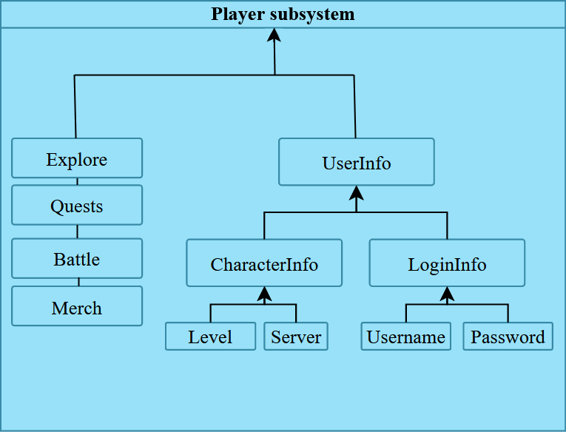
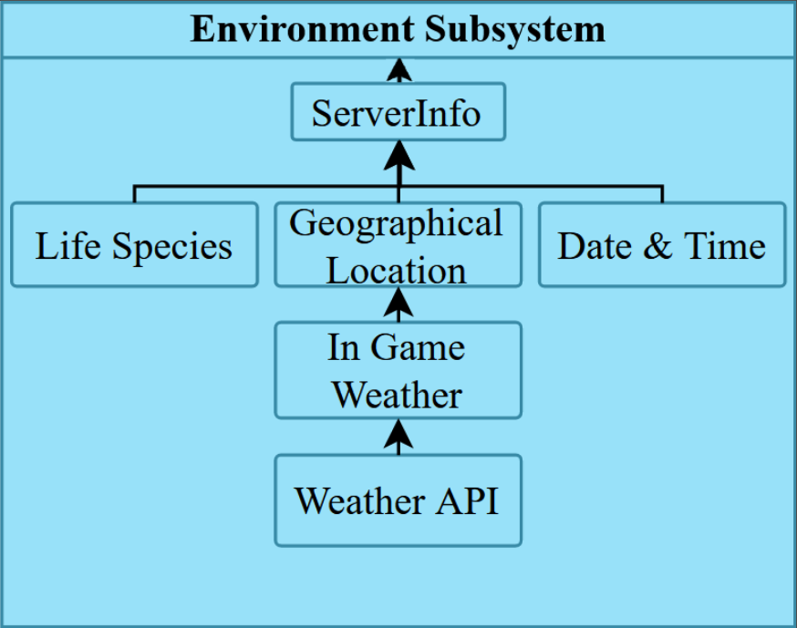
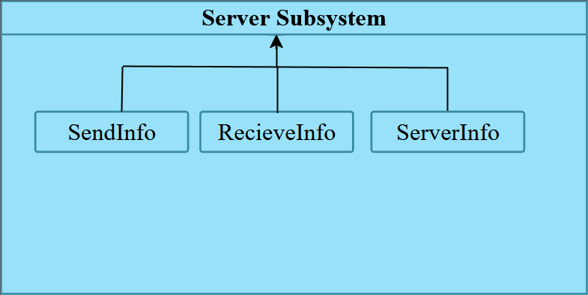
System Design: Subsystems

Slide 9
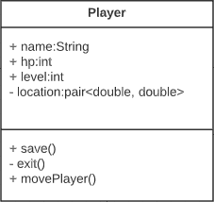
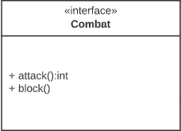
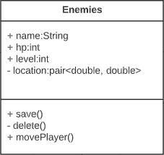
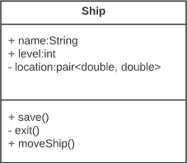
System Design: Classes

